Slide 1
MODIS LAI in GEE

Slide 2
Choosing MODIS Product

Slide 3
Choosing the MODIS product to use: background info
MYD09Q1.005 Surface Reflectance 8-Day L3 Global 250m: Low-level data are corrected for atmospheric gases and aerosols, yielding a level-2 basis for several higher-order gridded Level-2 (L2G) and level-3 products. Each pixel here contains the best possible L2G observation during an 8-day period as selected on the basis of high observation coverage, low view angle, absence of clouds or cloud shadow, and aerosol loading. (do they provide the actual date for the pixel? If they do, it could be very useful)
MOD09GB.005 Terra Surface Reflectance Daily L2G Global 250m: This is mean to be used in conjunction with MOD09GA where important quality and viewing geometry information is stored
MOD09GA.006 Terra Surface Reflectance Daily Global 1km and 500m: Has bands 1-7 at 500m, and includes bitmasks for clouds, cloud shadows at 1km, also sensor zenith, solar zenith, bitmasks for data flags
MODIS Terra Daily NDVI: This is generated from MODIS/006/MOD09GA surface reflectance COMPOSITES, but maybe they will have actual dates that we can use…
MODIS Aqua Daily NDVI: Generated from MODIS/006/MYD09GA surface reflectance COMPOSITES
MODIS Terra Daily EVI, MODIS Aqua Daily EVI
MCD43A4 BRDF-Adjusted Reflectance 16-Day Global 500m: Adjusted 500m reflectance data using BRDF to model the values as if they were taken from nadir view. Used both Terra and Aqua, meaning it’s an MCD – a combined product.
MCD15A3H.006 MODIS Leaf Area Index/FPAR 4-Day Global 500m: 4-day composite at 500m. Algorithm chooses the “best” pixel available from all the acquisitions of both Terra nad Aqua satellites within a 4 day period. 2002 to 2018. Does it include actual dates for each pixel or only the 4 day range? Gives one-sided green leaf area per unit ground area. Has bitmask for clouds, quality, cloud shadow. Description:https://explorer.earthengine.google.com/#detail/MODIS%2F006%2FMCD15A3H
MCD43A4_NDVI is NDVI calculated from NBAR inputs (nadir corrected) – the MOD13Q1 VI product doesn’t have nadir corrected. However, this seems to be based on 16 day composite…
MOD13Q1: Has EVI and NDVI, and the CDOY band has information, per pixel, on the date used. Doesn’t seem to be listed as a band in GEE…

Slide 4
(Testa et al, 2014)
The MOD13Q1 16-days composite product is obtained by selecting for each pixel the best observation that occurred in the 16-day reference period. All the available images are compared according to a Quality Assurance (QA) filtering criterion that takes care of signal quality, cloud contamination and viewing geometry. Nadir and cloud-free pixels have the best QA rank. The number of images falling in the 16-day reference period ranges between 0 and 64 (1 to 4 acquisitions a day are possible; persistent cloudiness causes poor observation quality). Usually, the number of good quality images varies between 1 and 5 per period and in general decreases from the poles toward the equator. When the best images have been selected, two compositing strategies can be applied. If the number of well-ranked images is two or more, the compositing strategy is the Constraint View angle – Maximum Value Composite (CV-MVC), which selects the closest-to-nadir acquisition. Otherwise, the number of available acquisitions (without considering their QA rank) is evaluated; if it is more than one, the classic Maximum Value Composite (MVC) technique is applied selecting the image in which the highest NDVI value occurred. If a certain position has no good acquisition available, the correspondent pixel is filled with the historic average value: this is the reason why no missing data can be found in any TS image.

Slide 5
Compare the following:
 | MODIS LAI/FPAR 4 day 500m *** | MCD43A4 | MOD09GA daily L2G | MODIS Aqua Daily NDVI
GEE Image ID | MODIS/006/MCD15A3H | MODIS/006/MCD43A4 | MODIS/006/MOD09GA | MODIS/006/MYD13A1
Bands | LAI | 1-7 | 1-7 | EVI, NDVI, 1-3, 7
Resolution | 500m |  | 500m and 1km | 500m
Composite? | 4-day | 16 day, image’s date is the 9th day | no | 16 day
Actual acquisition date? | No DOY band | No DOY band | N/A | No DOY band
Nadir correction | Need to do – remove pixels w/ sensor zenith angle more than 32.25 deg | yes | Need to do – remove pixels w/ sensor zenith angle more than 32.25 deg
Cloud/shadow correction |  | Use band 3 >10%? | Use bitmasks (at 1km res) | EVI and NDVI have been cloud, shadow masked
Quality filtered?
Notes | Tested by (Tian et al, 2002). Uses both sensors
For clouds, remove all band 3 > 10% even for composites because maybe it will be cloudy for 8 days

Slide 6
 | MODIS Terra or Aqua SR 8-day 500m *** | MODIS Terra or Aqua VI 16 day 250m *** | MODIS Nadir BRDF-Adjusted Reflectance Daily 500m
GEE Image ID | MODIS/006/MOD09A1 or MODIS/006/MYD09A1 | MODIS/006/MOD13Q1 or MODIS/006/MYD13Q1 | MODIS/006/MCD43A4
Bands | 1-7? | EVI – calced from cloud-free MOD13A2; and NDVI; and bands 1-3, 7 | 1-7
Resolution | 500m | 250m | 500m
Composite? | 8 days | 16 days | 16 days
Actual acquisition date? | Used date of obs flag as day of the year for obs for each pixel – instead of assuming evenly spaced obs Has the day of pixel composite info | Composite day of year layer was introduced starting with Collection 5 (Testa et al, 2014) have a technique to recover temporal accuracy to get uniform timeseries | No DOY band “image date” is the 9th day in the 16 day period
Nadir correction | Need to do – remove pixels w/ sensor zenith angel more than 32.25 deg | yes | yes
Cloud/shadow correction | Already chose the lowest value of band 3 every 8 days, still need to remove all band 3 >10% | Cloud-free already
Quality filtered?
Notes | Used in (Sakamoto, 2005) and in (Galford et al, 2008) and rally dataset | Used in (Urban et al, 2018) and (Boschetti et al, 2009) and (Guinden-Garcia, 2012) and (Hmimina et al, 2013) | Used in (Zhang et al, 2003) – a similar NBAR adjusted, 16 day one

Slide 7
 | Modis Aqua SR 8 day | MODIS Aqua SR daily
GEE Image ID | MODIS/006/MYD09GQ | MODIS/006/MYD09GQ
Bands | 1-2 | 1-2
Resolution | 250m | 250m
Composite? | 8 day | no
Actual acquisition date? | No DOY band | N/A
Nadir correction
Cloud/shadow correction
Quality filtered?
Notes | Use with MOD09GA where quality and viewing geometry info is stored | Used in (Hmimina et al, 2013) – they did MOD09GQK. The data was noisy even after QA filtering. Should use with MOD09GA
Aqua – overpasses in the morning and has longer time domain, mornings tend to be more cloud free.
CVA-MVC compositing method preferentially selects NDVI values with zenith view angle closest to nadir view
MOD = Terra
MYD = Aqua
BRDF = Bidirectional Reflectance Distribution Function. how important is it to have nadir-adjusted? Especially when the composites already try to pick the smallest zenith sensor angle?

Slide 8
Final Choices | MODIS LAI/FPAR 4 day 500m *** “MODIS_LAI” in GEE code | MODIS Terra or Aqua SR 8-day 500m *** “MODIS_8day” in GEE code | MODIS Terra or Aqua VI 16 day 250m *** “MODIS_VI” in GEE code
GEE Image ID | MODIS/006/MCD15A3H | MODIS/006/MOD09A1 or MODIS/006/MYD09A1 | MODIS/006/MOD13Q1 or MODIS/006/MYD13Q1
Bands | LAI | 1-7 | EVI – calced from cloud-free MOD13A2; and NDVI; and bands 1-3, 7
Resolution | 500m | 500m | 250m
Composite? | 4-day | 8 days | 16 days
Actual acquisition date? | No DOY band | Has DOY band | Has DOY band (Testa et al, 2014) have a technique to recover temporal accuracy to get uniform timeseries
Nadir correction | remove pixels w/ sensor zenith angle more than 32.25 deg? But it’s already ok b/c of composite
Cloud/shadow correction | remove all band 3 >10%? But it’s already ok b/c of composite
Notes | Tested by (Tian et al, 2002). Uses both sensors | Used in (Sakamoto, 2005) and in (Galford et al, 2008) and rally dataset | Used in (Urban et al, 2018) and (Boschetti et al, 2009) and (Guinden-Garcia, 2012) and (Hmimina et al, 2013)

Slide 9
MODIS LAI timeseries in GEE

Slide 10
In GEE: MODIS Phenology, MODIS Phenology v2 and v3
Reading in csv of rally points: took subset of rally points because of computation space. It seems to read in lat and long, so in the rallypoints_subset.csv, physically switched the column order and labeled “y” as lat and “x” as long.
Renamed the “year” column to “blah” to be able to filter out points by year
Work with “rallypoints_subset” or “rallypoints_full”, which have the lat/long and “blah” edits
In version 2, used KrossNDVI to calc LAI for the 8day and VI MODIS products, and also the MODIS LAI product. Generate charts comparing the three products for a single point, given by pointID. Chart generation, etc is all copied and pasted.
In version 3, start using a separate script for getting each MODIS product x LAI calc method to generate a chart.
Scaling factors:
MYD13Q1 (Aqua Veg Indices 16 day 250m product) has NDVI and EVI that need a scaling factor of 0.0001
MCD15A3H (MODIS LAI 500m product) has LAI that needs a scale factor of 0.1

Slide 11
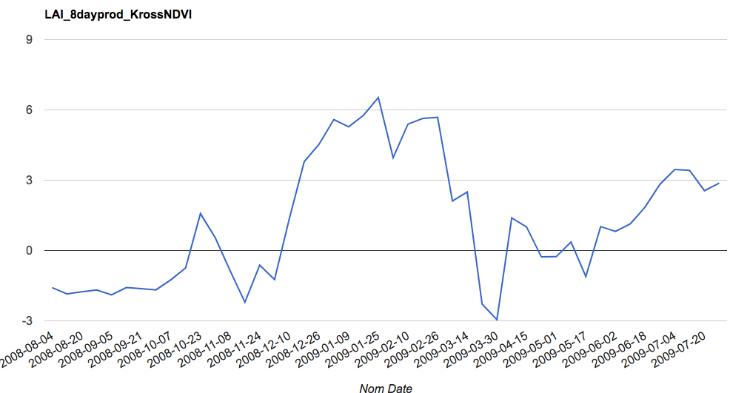
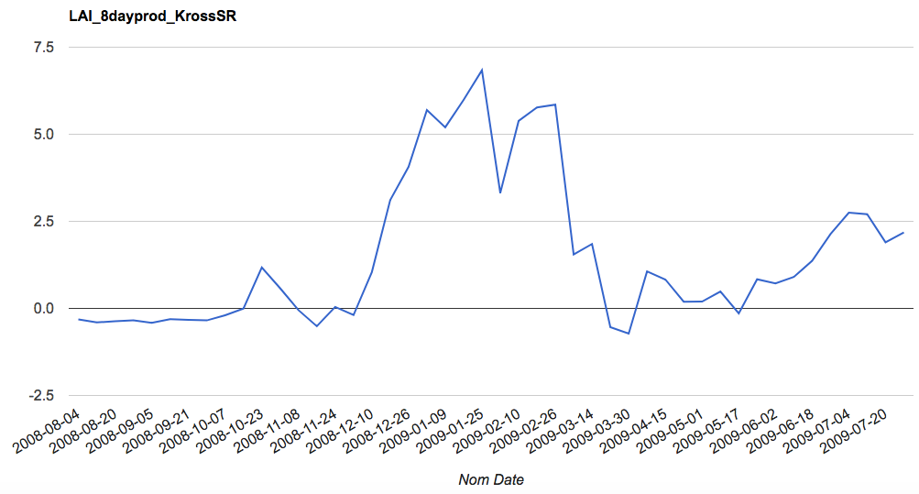
LAI calculations (before visually inspecting for clouds, shadows, etc)
MODIS product: 8-day composite, MYD09A1
LAI eqn: “Kross NDVI”
The x-axis for all six plots is nominal date (evenly spaced), but the csv files that I’ll send you will have actual acquisition dates in DOY.
MODIS product: 8-day composite, MYD09A1
LAI eqn: “Kross SR”
I will do some more cloud filtering for the 8-day composites, that should make the data less noisy – but I suspect it will then look at lot like the 16-day composite. So it would be the same temporal resolution as Landsat, but a worse spatial resolution than Landsat…

Slide 12
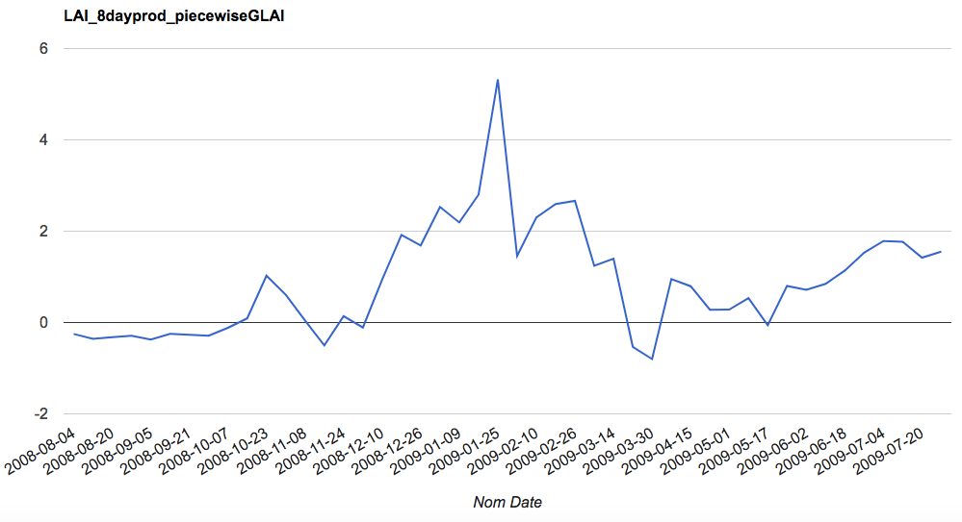
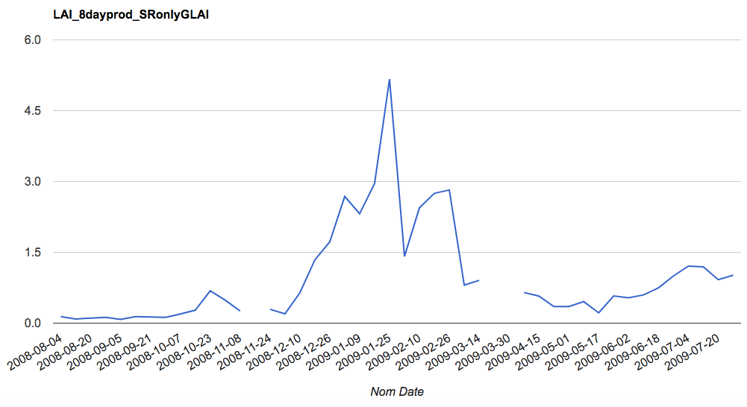
LAI calculations (before visually inspecting for clouds, shadows, etc)
MODIS product:8-day composite, MYD09A1
gLAI eqn: “piecewise”
These two plots are gLAI, but I’m including them to compare to the MODIS LAI product on the next slide
MODIS product: 8-day composite, MYD09A1
gLAI eqn: “SR only”

Slide 13
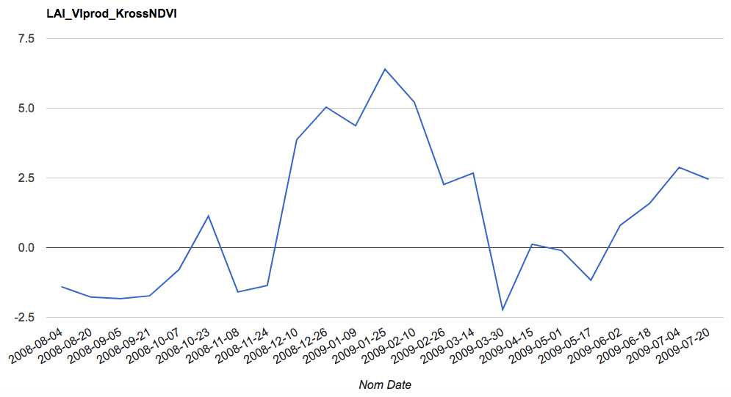
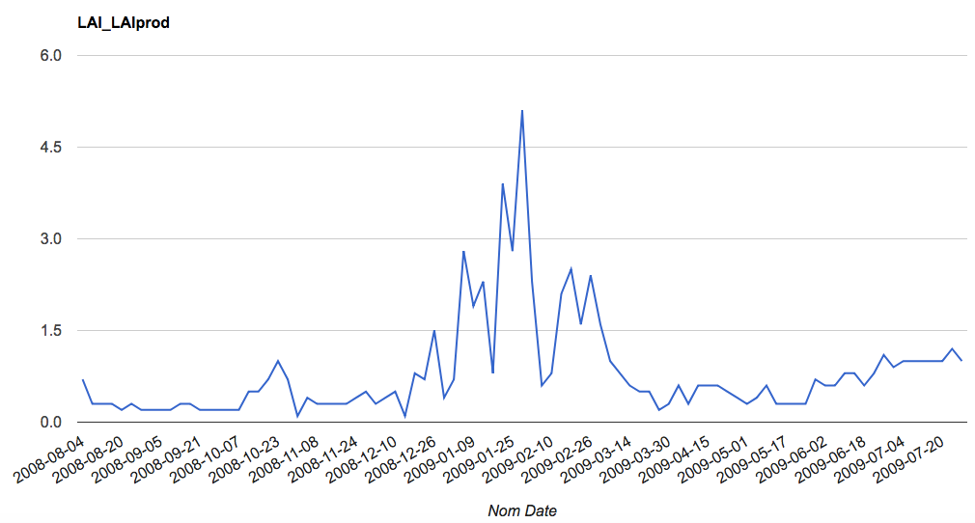
LAI calculations (before visually inspecting for clouds, shadows, etc)
MODIS product: Veg Indices, 16 day composite, MYD13Q1
LAI eqn: “Kross NDVI”
This was calculated using the NDVI band. I can find another LAI equation to use this product’s EVI band. Do you want that?
MODIS product: LAI, 4 day composite, MCD15A3H
The MODIS LAI product looks like gLAI instead of LAI…
It also has a lot more noise than the other composites, probably because 4 days isn’t enough to avoid clouds
Therefore, I’m thinking we won’t use the MODIS LAI product?

Slide 14
New VI – LAI equations
(Nguy-Robertson et al, 2012)
“NguyRobertsonGCVI”
LAI = ([GCVI – 1.08]/1.38)^0.767
Where GCVI = (NIR/GREEN) - 1
“KrossSR” is the best from the previous six – so keep that one

Slide 15
Cleaning up clouds and sensor zenith angle
Three cloud options:
“Method 1”: clean up using bits 8-13 in StateQA band
“Method 2”: clean up using bits 0-2, 8-9 in StateQA band
“Method 3”: mask out any pixels with blue band > 10% (but not sure what the max is to take this percentage) – this one didn’t take out any pixels….
Zenith angle:
Take out sensor zenith angles > 32.25 in ViewZenith band
Don’t do NBAR adjustments because we don’t want to introduce systematic biases.
Compare combos of cloud masking x zenith to no masking at all. Look at whether the masked images:
-have enough points in the timeseries, especially to capture peak location and value
-cut off the peak or lower it by not capturing the max

Slide 16
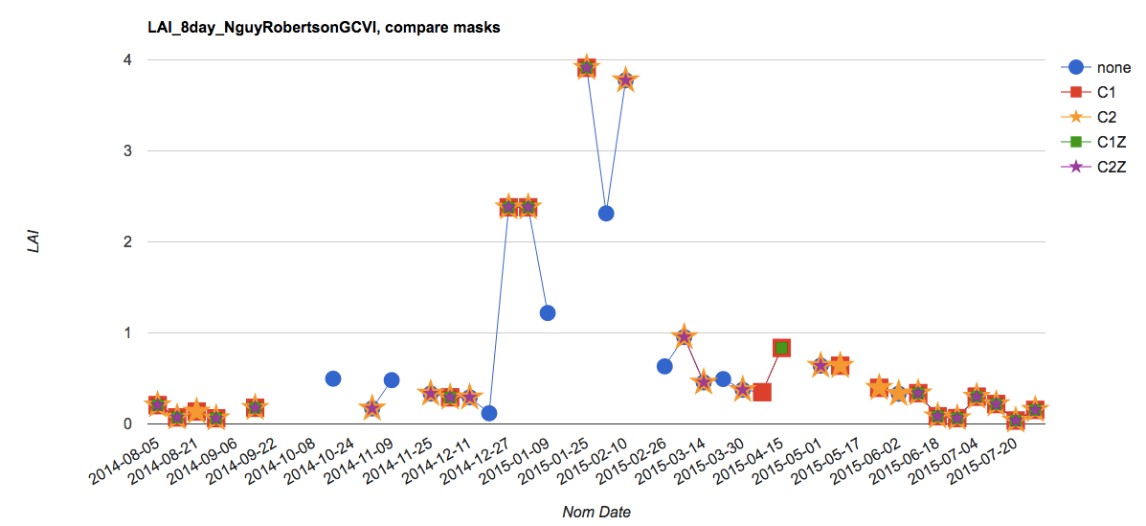
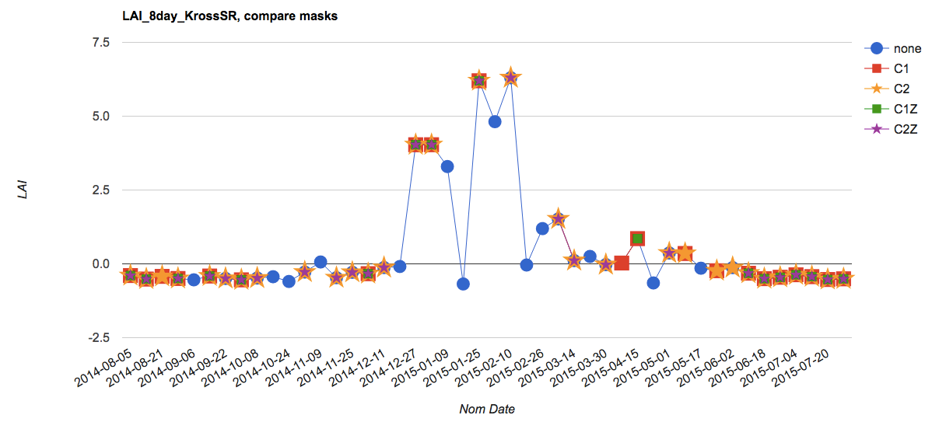
From Modis Phenology v3:
C1 = “Method 1” cloud mask
C2 = “Method 2” cloud mask
Z = “Zenith angle” cloud mask
C2 cloud mask (stars) does the best – doesn’t take out too many points but still gets rid of the extreme dips in LAI in the peak growing season
C1 cloud mask (squares) gets rid of a peak LAI, and also a lot of the lower LAIs
C2Z is ok; doesn’t get rid of too many extra points. The points it does get rid of don’t seem like outliers.
Nguy-RobertsonGCVI as an exponential, and there are therefore a lot of “null” LAI values.

Slide 17
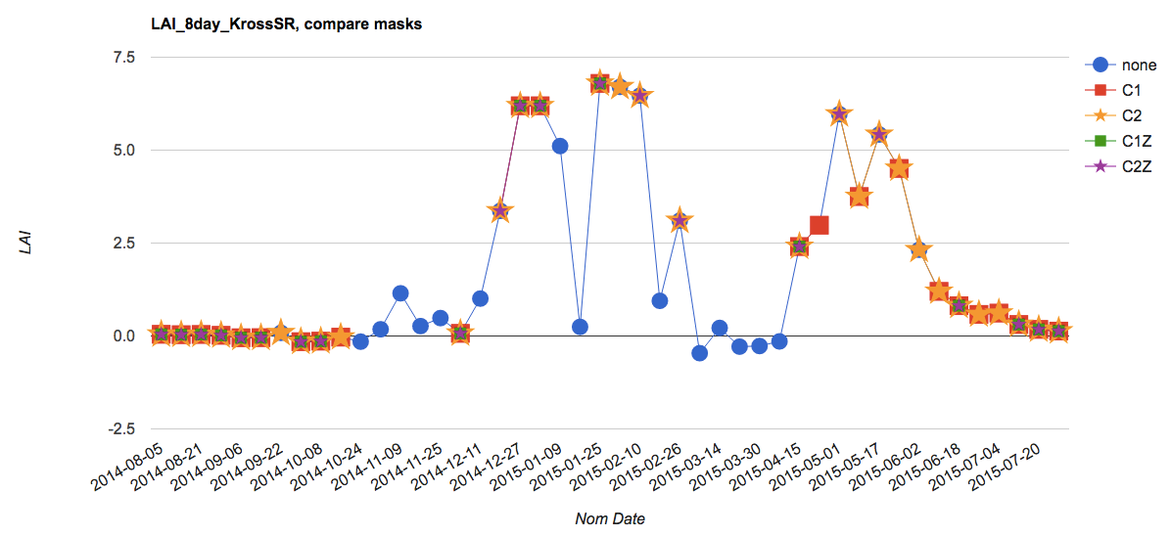
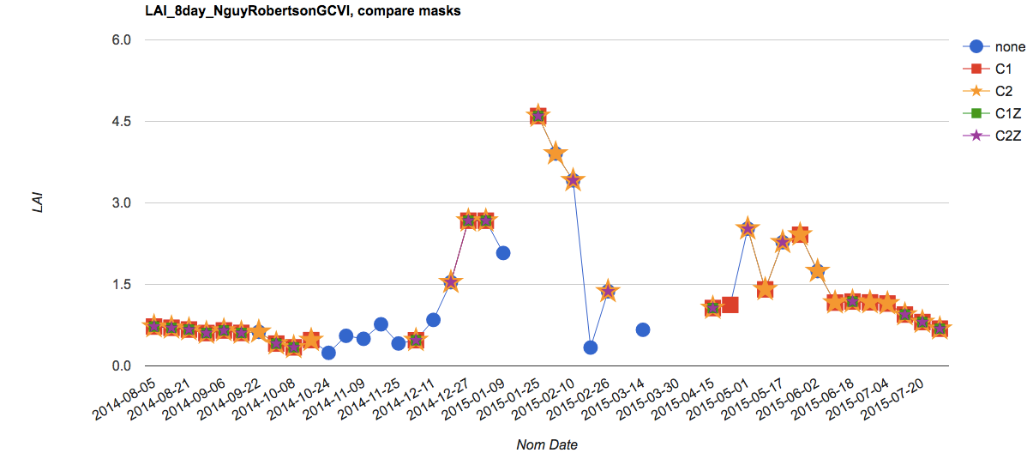
Here, C2Z gets rid of some spurious points that C2 doesn’t.

Slide 18
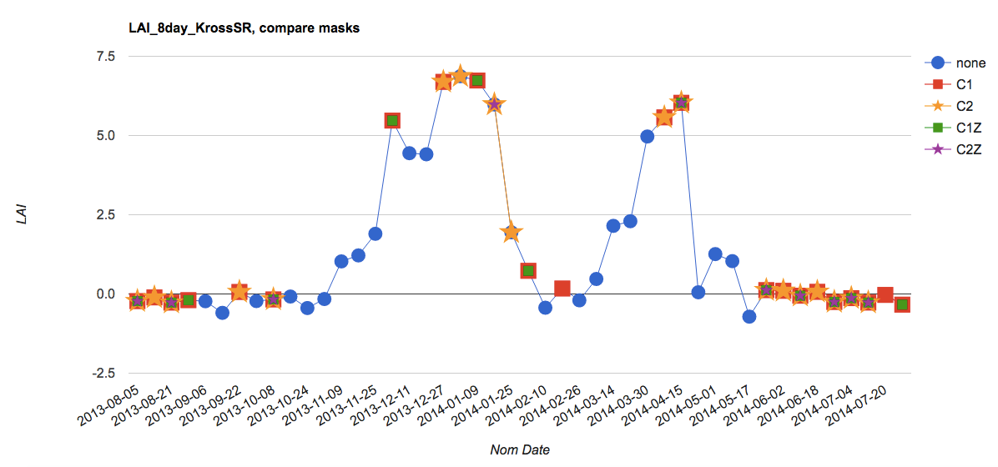
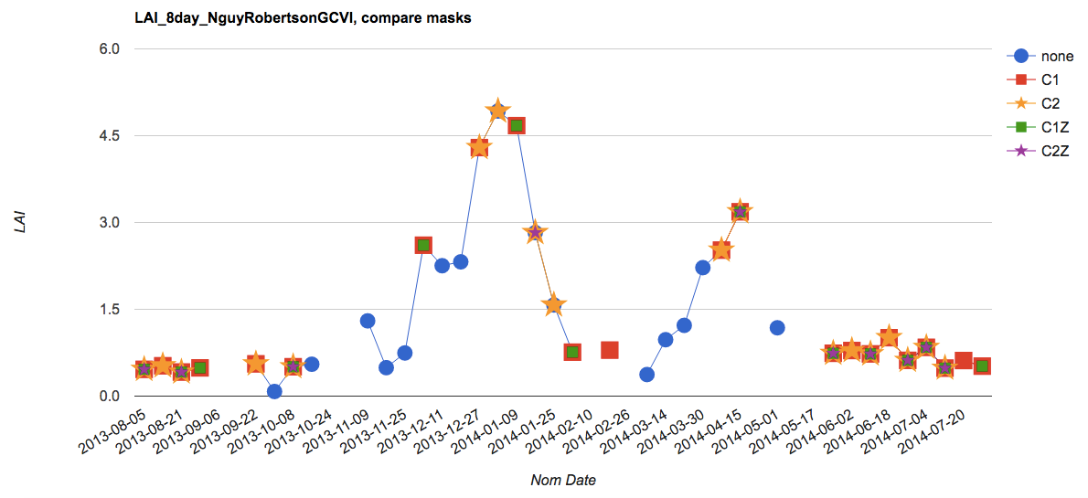
Here, C2Z gets rid of too many points; maybe C2 alone is good.
C2 is still better than C1… but the advantage isn’t as clear because C2 doesn’t get the “lows” right in February

Slide 19
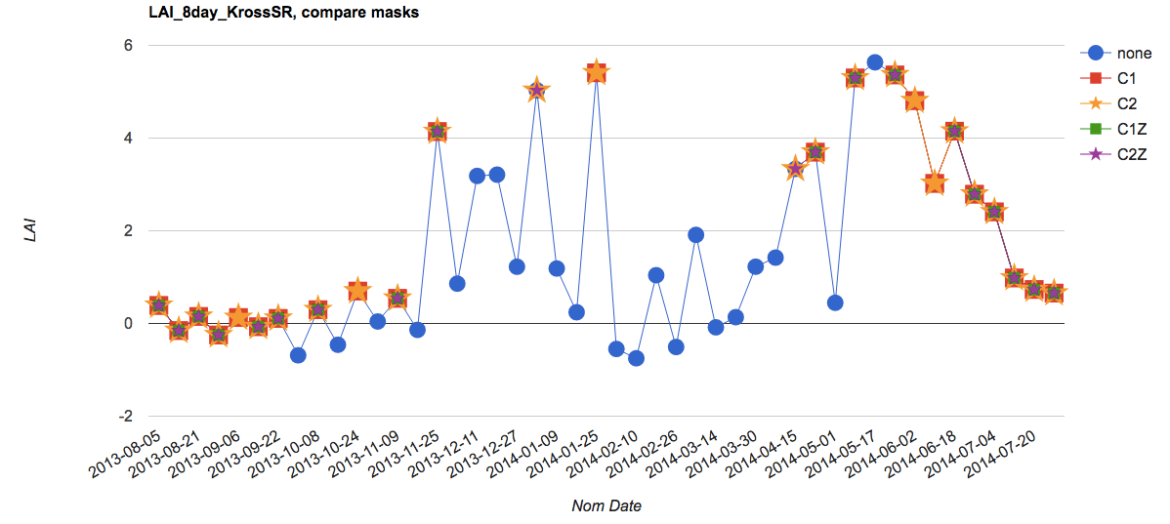
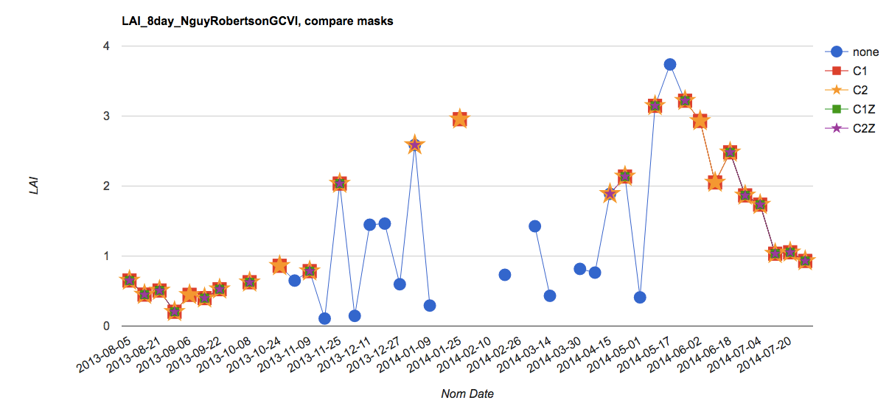
The “lows” in Feb again aren’t captured by either C1 or C2. sometimes one point is all that is available to determine whether a peak or dip exists.

Slide 20
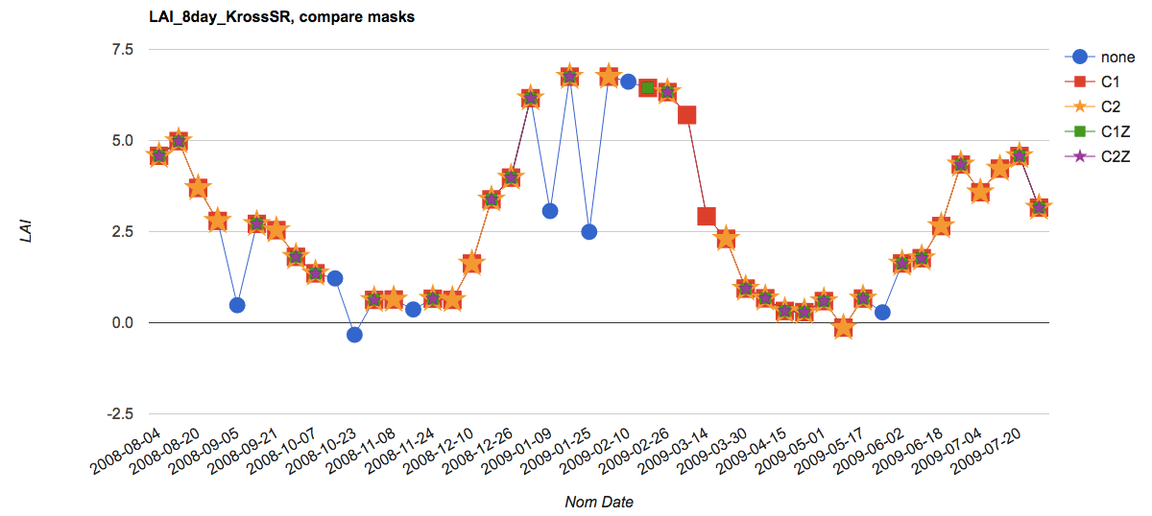
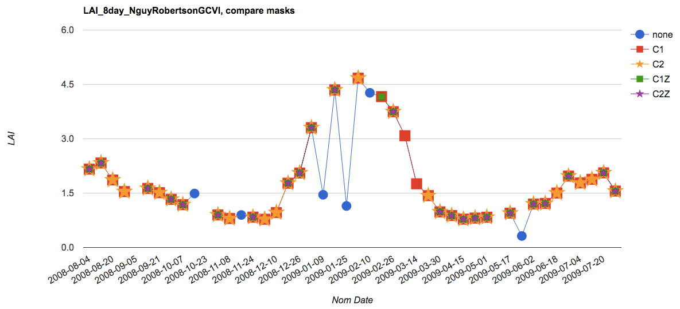
Here, C1 and C2 are similar, and they both do a good job getting rid of the spurious dips

Slide 21
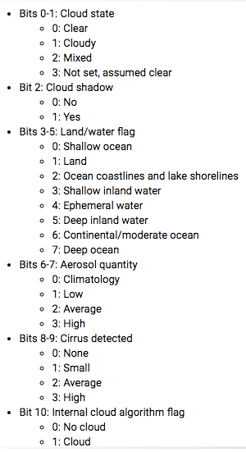
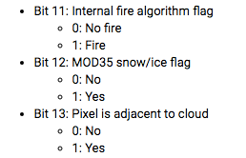
“C1” masks out the following in the StateQA band:
Bit 8 and 9: want it to be 00 (no cirrus)
Bit 10: want it to be 0 (no cloud in internal cloud flag)
Bit 11: want it to be 0 (no fire in internal fire flag)
Bit 12: want it to be 0 (no snow/ice)
Bit 13: want it to be 0 (pixel is not adjacent to cloud)
“C2” masks out the following in the StateQA band:
Bits 0 and 1: want it to be 00 (clear)
Bit 2: want it to be 0 (no shadow)
Bit 8 and 9: want it to be 00 or 01 (none or small cirrus)
00 = 0
01 = 1
10 = 2
11 = 3
The numbers are hex decimal

Slide 22
Bitmask background
A bit is a single number in 0000
A byte is the eight numbers, 0000 0000
Bitmask: set the bit you want to check as 1, e.g. 0010 0000 to test third bit. Then use (thing to test) “and” (bitmask); this will return something other than zero if the thing we want to test has the feature we’re looking for.
0x means hex. 0000 0000 = 00 in hex; 1111 1111 = FF in hex. A hex contains four bits = half a byte.
2^0 in binary is 1 (assume zeros on the left to fill in the full 8)
2^1 in binary is 10
2^3 in binary is 1000
2^4 in binary is 10000 and so on
For 1100, the second and third position are the 1’s. Count bits from the right.

Slide 23
Tasks
DUE June 13: Mask of single/double cropped areas – pick the Morgen class for the Rally pixels so Gabriel can see how they relate to onset-greenup
DUE June 13: Soy classification maps: Obtain all relevant soymaps and decide on combining maps if necessary. overlay Pequisa agri municipal data as a “check”
DUE June 18: Determine representativeness of yield data
DUE June 25: Sample new soy pixels
DUE June 30: Phenology calculations (planting, harvest estimates) for all sampled soy pixels
To Do
LAI example points using MODIS. GEE tricks to code: show timeseries of a point on click. Inspect for clouds visually.
Clean Matopiba planting/harvest date data and read into GEE – add in data quality/error flag on worded dates
Look at WDRVI in rally points for an idea of phenology.
Visually inspect MODIS phenology for clouds – try masking out only certain bits (like only cloud bit, only cloud shadow bit, and visually inspect it. Read about bitmasking in GEE.
Put in GEE a way to get a sense of the spread in planting, harvest dates and how different pixels look from each other. To calc planting/harvest, first think about how we will separate different peaks due to crops, and how to separate the weed peaks from the crop peaks. Think about an algorithm to divide the timeseries into chunks in which we expect a planting and a harvest date. Think about all the ways things could go wrong and try to make an algorithm that can account for those situations. Look for peak detection methods (i.e. filter out the weed peaks by looking at thresholds in peak characteristics). Harvest, at high resolution, should look like a period of steepest descent. So inflection may be questionable. Maybe look for timeseries analysis in GEE, otherwise do this in R. Look at June 6 2018 powerpoint for info on papers.
Ask Avery or Gabriel:
For the single vs double cropping data: ask Avery if this data represents the farmers’ intention vs what they actually did.
What is our tolernce for clous? Cirrus ok?
Notes:
All weather data will be interpolated (Tmin, Tmax, Tavg, wind speed, specific humidity, precip, radiation); interpolation will happen during the process of going from pixel to list
Classify pixels into region in the native weather data grid
Ask Dave – what does he do for gridded weather? What dataset does he use? Does he interpolate?
My work:
Bottleneck: Ask about datasets. Ask about cyberinfrastructure. Need: onset, Rally da Safra, LC Morgen soymap, Mapbiomas, other land use classifications, single vs double crop maps
Compile soymap and yield data
Determine rep of yield data
Select new soy pixels if necessary
Tie LAI info to the selected and yield soy pixels

